Slide 1
rainfall prediction using machine learning
Team-12

Slide 2




Team Members
Vinodh Kumar Chimpiri
Machine Learning Engineer
Snithika Patel Talasani
Data Engineer
Sneha Vangala
Story Teller,
Data Scientist
Anwar Rashid Shaik
Bigdata Engineer

Slide 3
Contents
What is the problem?
Who is it useful to?
Why should this problem be solved?
How will I know this problem has been solved?
Data acquisition and quality enhancement
Model selection
Logistic Regression
Model selection
CRISP METHODOLOGY

Slide 4

What is the problem?
Developing effective rainfall prediction models using machine learning.
Addressing the challenge of accurate rainfall forecasting.
Incorporating meteorological data and technology for predictions.

Slide 5

Who is it useful to?
Meteorologists and climate experts.
Data scientists and machine learning practitioners.
Government agencies and disaster management teams.
Communities in regions affected by weather events.

Slide 6

Why should this problem be solved?
To improve disaster preparedness and management.
To optimize resource allocation and reduce economic losses.
To support environmental conservation and sustainable development.

Slide 7
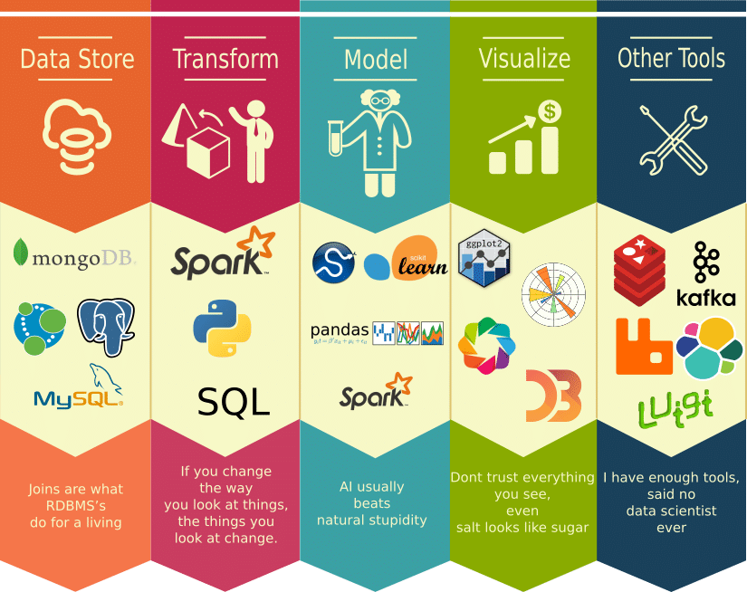
How to solve this problem?
Data acquisition and quality enhancement.
Feature engineering to capture complex interactions.
Model selection including time series, regression, and deep learning models.
Employing ensemble techniques for robustness.
Real-time processing for timely forecasts

Slide 8
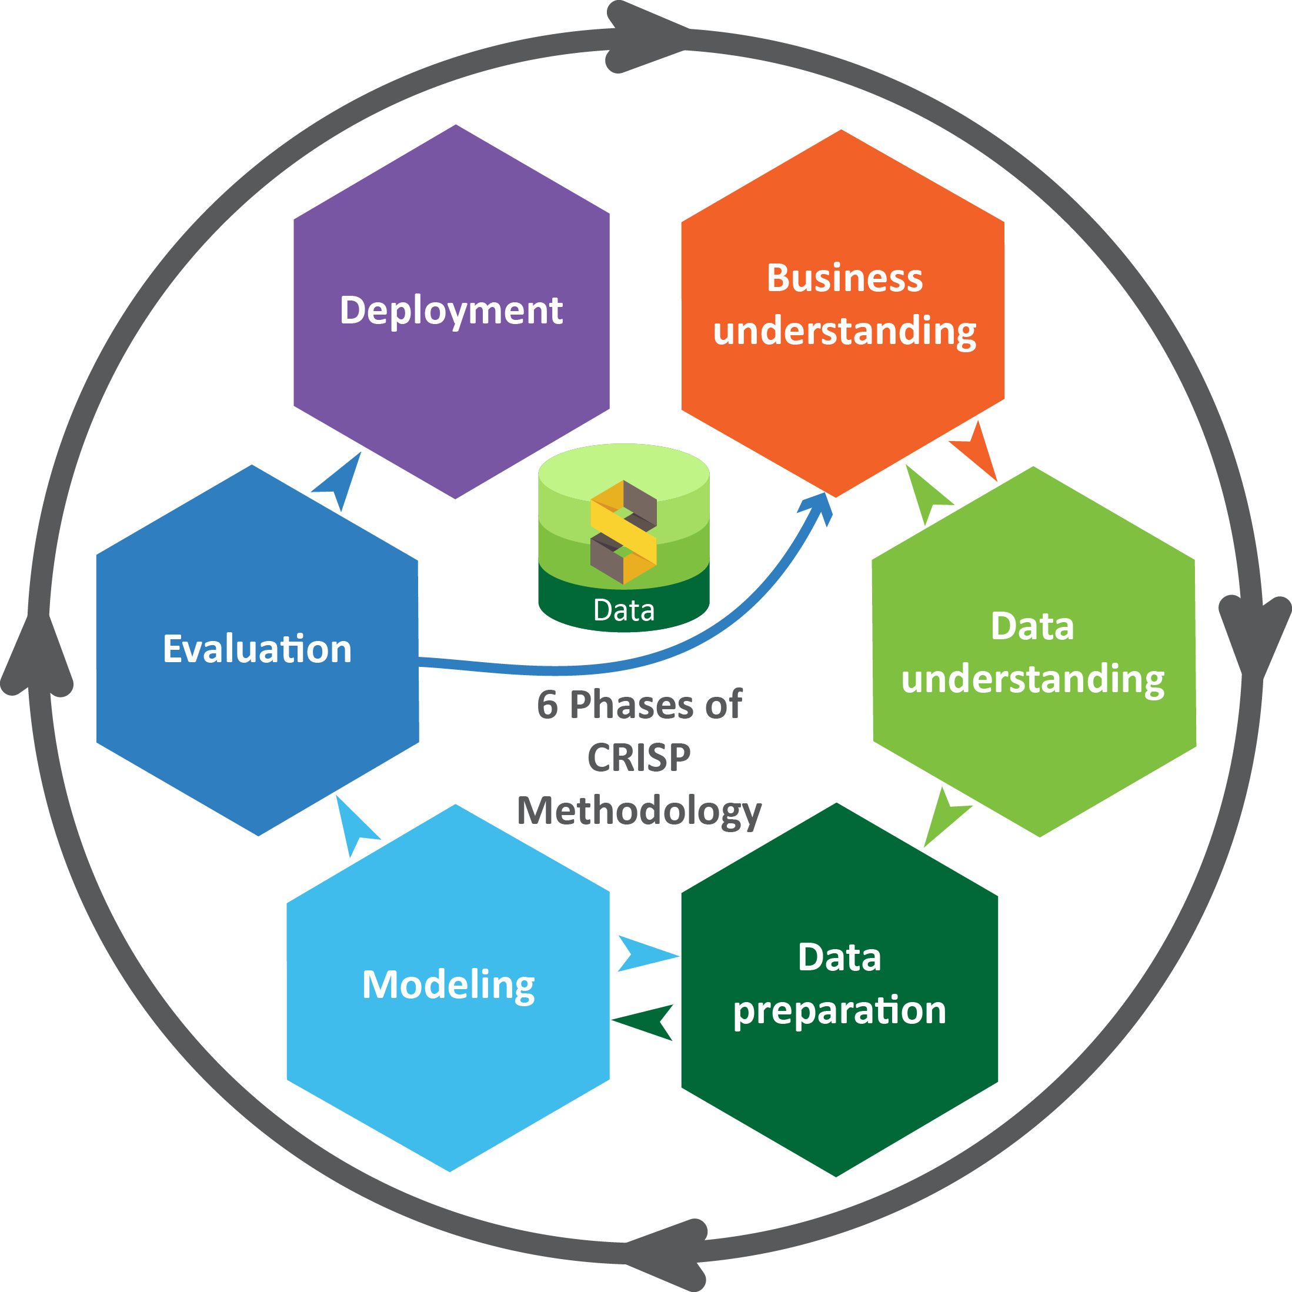
Crisp Methodology

Slide 9

Data acquisition
Kaggle provides diverse weather-related datasets, including historical rainfall data, making it a valuable resource for your project.
Ensure compliance with Kaggle's licensing agreements for any data you use.
Thoroughly explore and clean the data to understand its quality, structure, and characteristics.
Consider participating in Kaggle competitions and using the platform for collaboration and learning in the data science community.

Slide 10
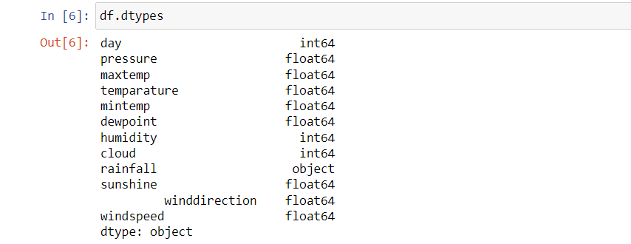
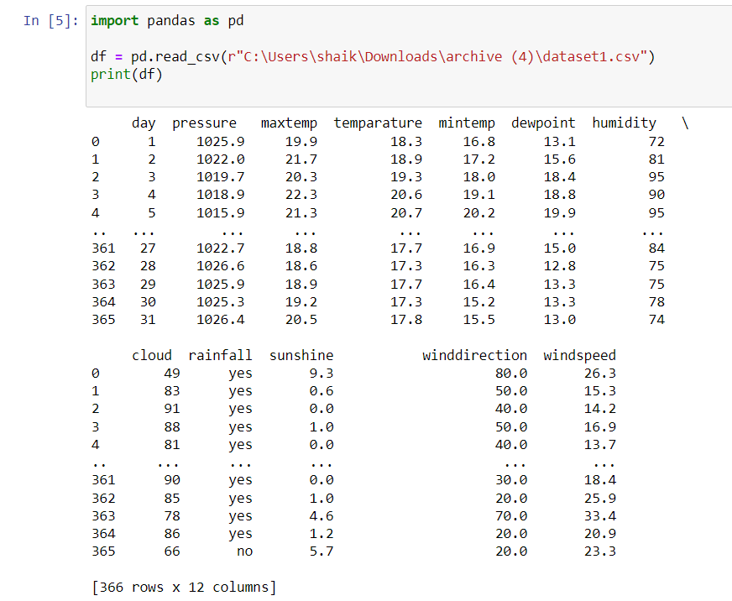
Sample Dataset
Columns-
day
Pressure
max & min temperature
dewpoint
Humidity
Cloud
Rainfall
Sunshine
Windspeed
wind direction

Slide 11
Model selection
Logistic Regression -
It is a supervised machine learning algorithm mainly used for classification tasks
The goal is to predict the probability that an instance of belonging to a given class or not.
Outcome can be a categorical or discrete value.

Slide 12
Model selection
Support Vector Machine (SVM) Algorithm
SVM is a powerful and versatile machine learning method used for both classification and regression tasks.
SVM works by finding a hyperplane that best separates data points of different classes.

Slide 13
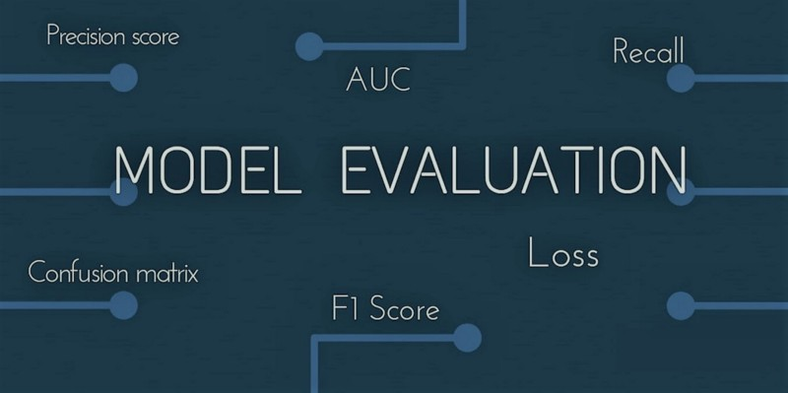
Evaluation Metrics
Accuracy
Precision
Recall
F1-score
ROC-AUC

Slide 14

Our project links
https://github.com/vinodhvinu438/DSDE-TEAM12#dsde-team12

Slide 15
Thank you

